Slide 1
Increasing Student Success:
New Math Pathways To and Through Gateway Math
CBMS Forum 5: October 2014
Treisman, Rotman, Fong

Slide 2
introduction
Problem addressed
Context of the reform
Uri

Slide 3
Origins
AMATYC Developmental Math Committee
Goal: Identify mathematics needed for success in college, in mathematics, and in science & technology
Teams used MAA, AMS, and other resources
Resulted in about 200 ‘outcomes’
Seattle meeting (2009): Blue Box, Green Box
Connections with Carnegie and Dana Center
Jack

Slide 4
Robust … Power
The blue box and green box courses dealt with ideas important in mathematics
Mathematics faculty (esp. 2-year) at the center
Support and further development within the mathematics community as well as change agents (Carnegie Foundation, Dana Center)
Long term commitment to collaboration
Jack

Slide 5
AMATYC’s Continuing Work
The “New Life Project” advocates a new curricular model
Mathematical Literacy … for three pathways (Statistics, Quantitative Reasoning, ‘STEM’)
Algebraic Literacy connects to STEM math and science
Commercial texts (publishers in the process)
Local adaptations; over 50 colleges, over 500 sections this semester (>10,000 students)
Jack

Slide 6
For information on “New Life”
AMATYC New Life Project
https://dm-live.wikispaces.com/
Blog in support of all 3 models
http://www.devmathrevival.net/
rotmanj@lcc.edu
Handout available
Jack

Slide 7
Overview and Results for Quantway and Statway
Networked Improvement Communities
Bernadine

Slide 8
QW1
QW2 or College Level QR Course
College
Math
Credit
SW
College
Math
Credit
Alg 1
Alg 2
College Math
College
Math
Credit
Semester 1
Semester 2
Semester 3
Notes:
For example, Statway – statistics taught on Day 1, with mathematics supported throughout, just in time

Slide 9
Building a Networked Improvement Community
Launched Community in July 2010
Implemented Pathways in 2011-12
4th year of implementation
Continuous improvement and feedback to colleges

Slide 10
Determining Efficacy of Pathways for each College
  STUDENT PERFORMANCE REPORTS on success rate for their own students vs. the Network-wide students
  STUDENT COMPARATIVE REPORTS on success rates of the college’s students compared with matched students in non-Pathway courses
  REPORTS ON EFFECTS OF INTERVENTIONS on student mindset, level of anxiety, and sense of belonging
  STUDENT PERSISTENCE REPORTS on accumulated credits post-Pathway

Slide 11



Statway: Time to Complete a College Level Math Course
1 Year
2 Years
6%
15%
Traditional Sequence
Triple the success rate in half the time.
Statway
51%
Notes:
In sharp contrast, for the first Statway cohort 51 percent earned college math credit through the one year intensive Statway experience. To put a quick capsule summary on these results, Statway colleges have tripled the success rate in half the time. Similar results for Quantway as well.
And most significant this is tripling of the success rate hold up for different racial.ethnic subgroups and both males and females. For AA is actually four times the success rate in half the time! Likewise, 4 times as likely for those students 2 or 3 levels behind. No only overall improvement by highly equitable in the distribution of those improvement. A social equity reform. Opening up opportunities for most disadvatnaged.
In addition, we continue to follow students over time. SW/QW students also acquire more college credits in the year following Statway than students who pursued the traditional sequence of courses.
So how do Community College Pathways accomplish this, triple the success rate in half the time? I now turn to my colleague Karon Klipple to take you on a quick tour inside the Pathways Initiative.

Slide 12
Quantway 1: Time to Complete Developmental Sequence
1 Term
2 Terms
21%
29%
Traditional Sequence
Double the success rate in half the time.
Quanttway 1
56%
Notes:
In sharp contrast, for the first Statway cohort 51 percent earned college math credit through the one year intensive Statway experience. To put a quick capsule summary on these results, Statway colleges have tripled the success rate in half the time. Similar results for Quantway as well.
And most significant this is tripling of the success rate hold up for different racial.ethnic subgroups and both males and females. For AA is actually four times the success rate in half the time! Likewise, 4 times as likely for those students 2 or 3 levels behind. No only overall improvement by highly equitable in the distribution of those improvement. A social equity reform. Opening up opportunities for most disadvatnaged.
In addition, we continue to follow students over time. SW/QW students also acquire more college credits in the year following Statway than students who pursued the traditional sequence of courses.
So how do Community College Pathways accomplish this, triple the success rate in half the time? I now turn to my colleague Karon Klipple to take you on a quick tour inside the Pathways Initiative.

Slide 13
Cumulative Pathway Enrollment

Slide 14
Consistent Success Rates Over Time: more students and more faculty teaching
Notes:
So – here we are getting ready to start year 4 of the Pathways
How have we been doing?
Thinking about the challenges of expanding to new colleges and adding new faculty at existing NIC colleges, we could be introducing lots of variation into the system.
Let’s check it out….
(CLICK)
For QW – well we remain remarkably successful. The early success wasn’t just the result of the hard work of a few hardy souls. The success holds over time.
(CLICK)
The story for SW is the same.
The ability to retain this level of performance - despite the strain that expansion – more sites, new faculty, etc. - is something everyone should be proud of.
You have been able to maintain the amazing outcomes that were so impressive in the first year of the NIC.

Slide 15
How do Pathway students perform vs. their counterparts?

Slide 16
Quantway’s success rate exceeds the comparison group’s in one half the time
The pass rate of the comparison group was calculated as successfully fulfilling dev math within two semesters as opposed to one semester for the Quantway group.
Notes:
The important point here is that Quantway students achieved a 56% success rate.
This is the first “apples-to-apples” comparison we’ve been able to provide you.
Even when we limit the comparison group to those most like QW students (more likely to be only 1 or 2 course levels below than the developmental math population at large), QW still out performs the comparison group by 19 percentage points.
And you are delivering this success rate in a single term.

Slide 17
Quantway is effective across different gender and race/ethnicity groups – Spring 2012
Note. “Other” also contains data from unknown race/ethnicity status.

Slide 18
Statway’s success exceeds the comparison groups in half the time: dev math through college level stat
The success rate of the comparison group was calculated as successfully fulfilling college math within two years as opposed to one year for the Statway group.
Notes:
Here we see how well Statway performed in only one academic year – by comparison.
In both comparison years, Statway delivered on its promise of “twice as effective in half the time” in an apples to apples comparison
So – How did we get here?

Slide 19
Statway is effective across different gender groups – 2011-2012
Note. Data from unknown gender status were excluded; very few were unknown. “Other” also contains data from unknown race/ethnicity status.

Slide 20
Statway is effective across gender groups – similar efffects in Year 2 - 2012-2013
Note. Data from unknown gender status were excluded; very few were unknown. “Other” also contains data from unknown race/ethnicity status.

Slide 21
Statway is effective across different race/ethnicity groups – 2011-2012
Note. Data from unknown gender status were excluded; very few were unknown. “Other” also contains data from unknown race/ethnicity status.

Slide 22
Statway is effective across different race/ethnicity groups – Year 2 - 2012-2013
Note. Data from unknown gender status were excluded; very few were unknown. “Other” also contains data from unknown race/ethnicity status.

Slide 23
Statway and Quantway
http://www.carnegiefoundation.org/developmental-math
pathways@carnegiefoundation.org

Slide 24

New Mathways Project
Uri Treisman
CBMS
October 5-7, 2014
an initiative of the Charles A. Dana Center and the
Texas Association of Community Colleges
Notes:
INTRODUCTIONS

Slide 25
The New Mathways Project (NMP) Model
A systemic approach to improving student success by reforming developmental and gateway mathematics based on four fundamental principles:
Multiple pathways aligned to specific but broad fields of study
Acceleration that allows students to complete a college-level math course more quickly
Intentional use of strategies to help students develop skills as learners that are directly linked to their courses
Curriculum design and pedagogy based on proven practice and linked to improvement protocols
Notes:
Introduce NMP principles: 4 minutes
The principles on the slide are shortened to enhance readability. Here are the full versions:
Multiple pathways with relevant and challenging mathematics content aligned to specific fields of study
Acceleration that allows students to complete a college-level math course more quickly than in the traditional developmental math sequence
Intentional use of strategies to help students develop skills as learners
Curriculum design and pedagogy based on proven practice
As you review the principles, tie them back to the discussion and to information you have about local innovations. Try to find opportunities to honor the local work.

Slide 26
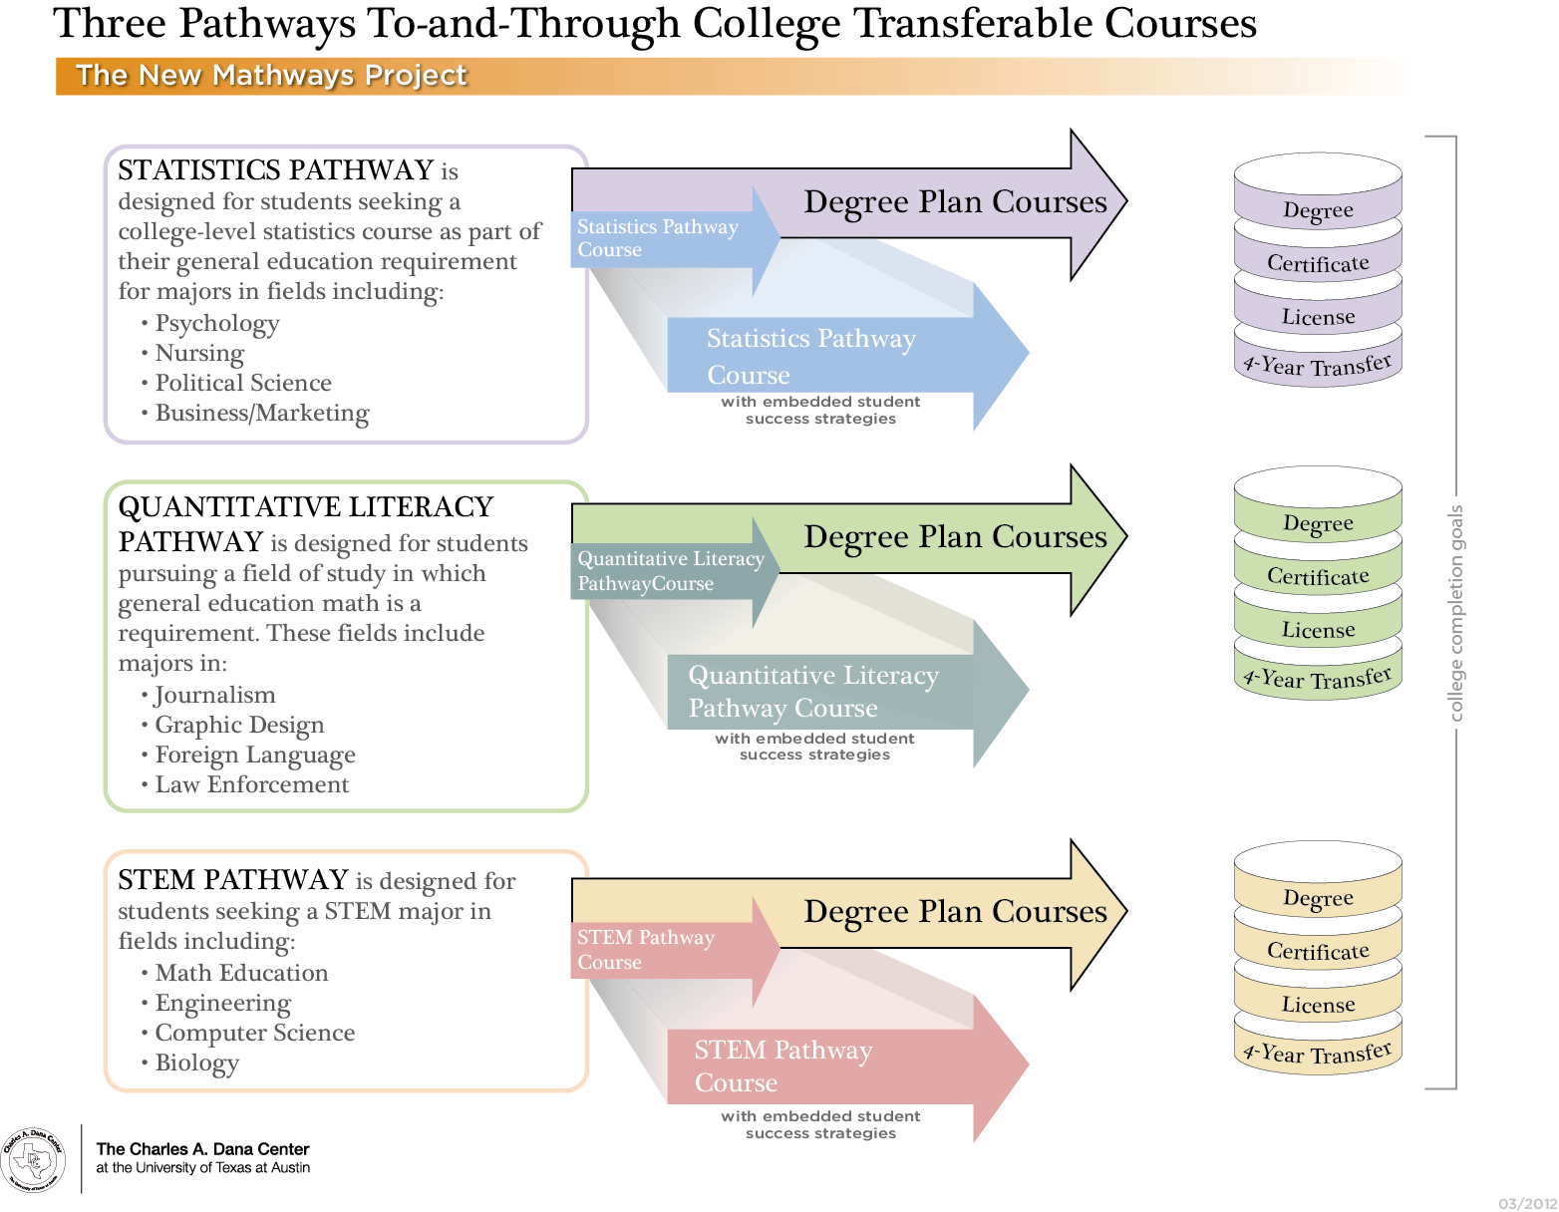
STATISTICS PATHWAY is designed for students seeking a college-level statistics course as part of their general education requirement for majors in fields including:
Nursing
Social Work
Criminal Justice
QUANTITATIVE REASONING PATHWAY is designed for students pursuing a field of study in which general education math is a requirement. These fields include majors in:
Communications
Graphic Design
Paralegal
STEM-PREP PATHWAY is designed for students seeking a STEM or mathematics-intensive major in fields including:
Petroleum Engineering
Computer Science
Chemistry

Slide 27
Dimensions of The New Mathway Project
State Policy
  Transfer Champions
  Negotiated Rule Making
Legitimation
  State Math Task Force Project (GA, OH, MT, MO, IN, NV, CO)
  TPSEmath, Vision 2025
Mobilization
  Cullinane’s Cycles of Mutual Permission Giving

Slide 28
Dimensions of The New Mathway Project
Implementation Support
  See www.utdanacenter.org/higher-education/
Design and Tool Development
  See www.utdanacenter.org/higher-education/

Slide 29

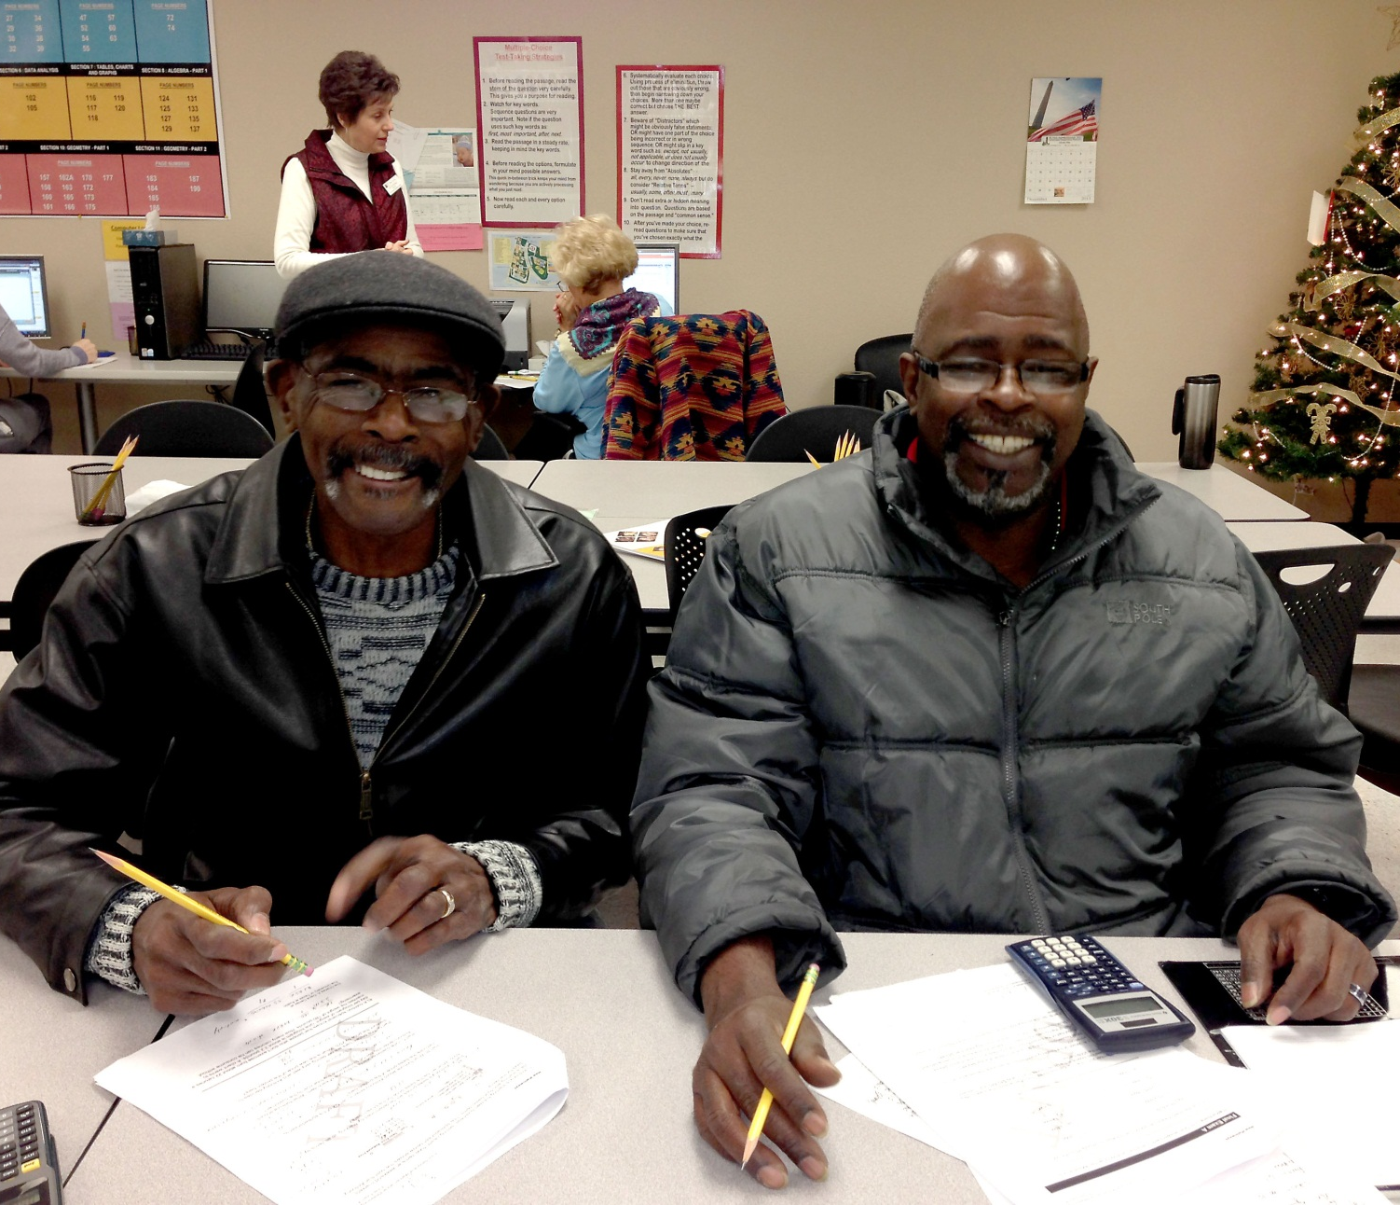
NMP Student Comments
Dr. Glenda Barron
I believe the group work is very helpful and provides opportunities for re-teaching and learning new ways to solve problems. Also, you form a bond with your group members and can count on them to help you.

Slide 30
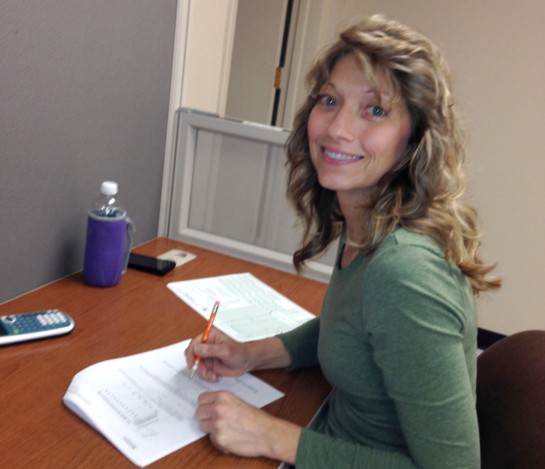
NMP Student Comments
  The class showed me how and why those mathematical formulas that traditional math makes you learn are useful and pertinent to me and my everyday life.

Slide 31
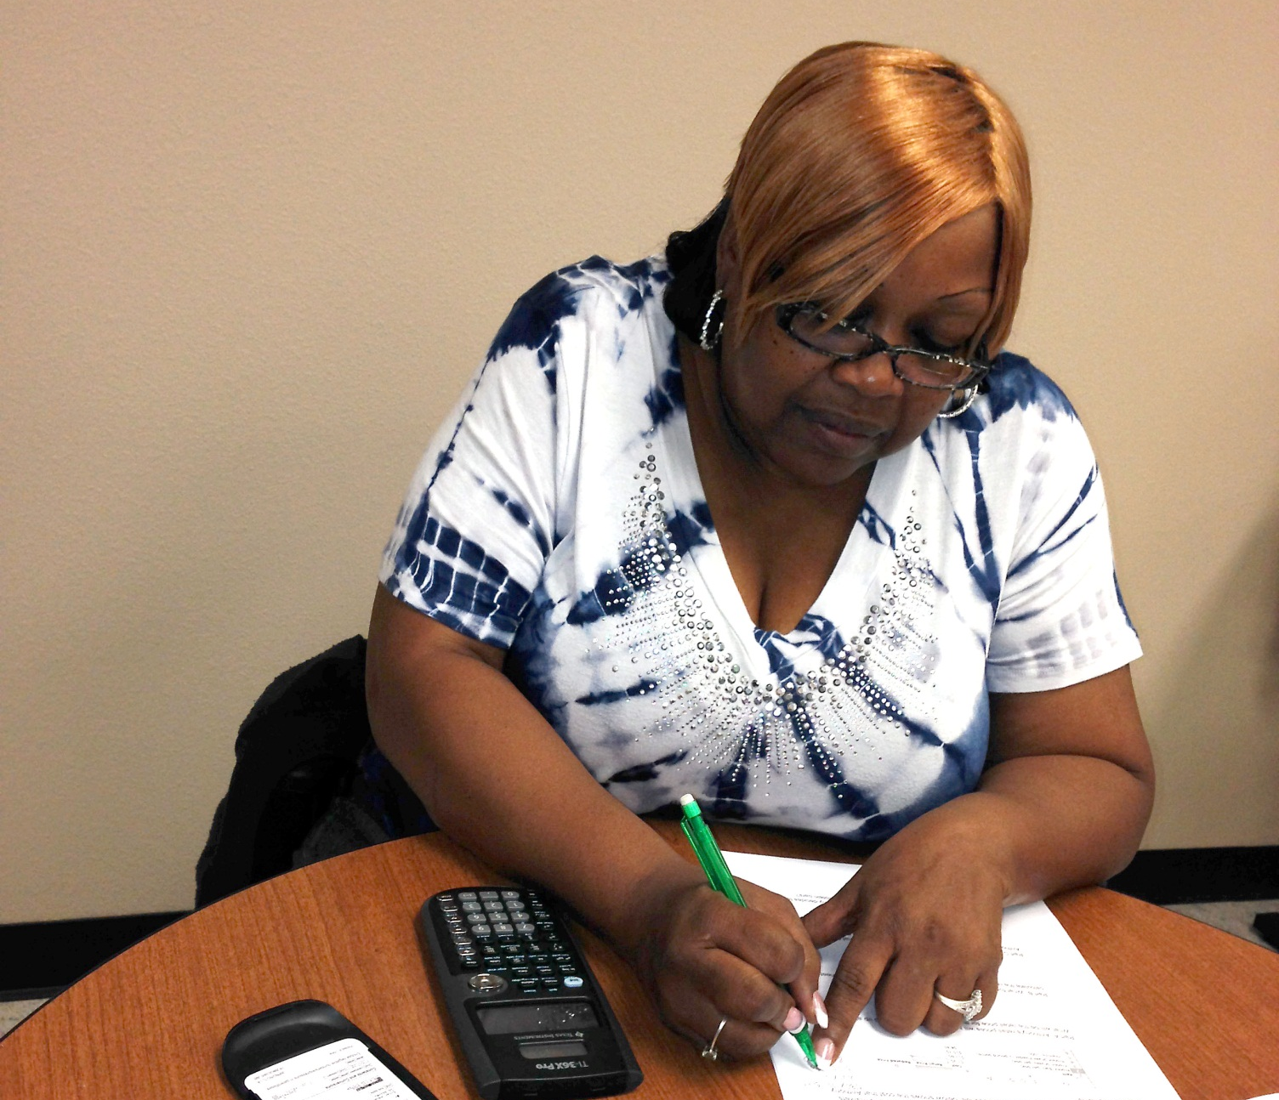
NMP Student Comments
NMP has given me back my self esteem when it comes to math. I used to be so scared I would not get my degree because I couldn’t pass the math classes.

Slide 32
For More Information
Uri Treisman uri@math.utexas.edu
To receive monthly updates about the NMP, contact us at: mathways@austin.utexas.edu
Higher Education work:
www.utdanacenter.org/higher-education/

